Slide 1
Introduction to Data Science Exploratory Data Analysis

Slide 2
Outline
Exploratory Data Analysis
Chart types
Some important distributions
Hypothesis Testing

Slide 3
Descriptive vs. Inferential Statistics
Descriptive: e.g., Median; describes data you have but can't be generalized beyond that
We’ll talk about Exploratory Data Analysis
Inferential: e.g., t-test, that enable inferences about the population beyond our data
These are the techniques we’ll leverage for Machine Learning and Prediction

Slide 4
Examples of Business Questions
Simple (descriptive) Stats
“Who are the most profitable customers?”
Hypothesis Testing
“Is there a difference in value to the company of these customers?”
Segmentation/Classification
What are the common characteristics of these customers?
Prediction
Will this new customer become a profitable customer? If so, how profitable?
adapted from Provost and Fawcett, “Data Science for Business”

Slide 5
Applying techniques
Most business questions are causal: what would happen if? (e.g. I show this ad)
But its easier to ask correlational questions, (what happened in this past when I showed this ad).
Supervised Learning:
Classification and Regression
Unsupervised Learning:
Clustering and Dimension reduction
Note: Unsupervised Learning is often used inside a larger Supervised learning problem.
E.g. auto-encoders for image recognition neural nets.

Slide 6
Applying techniques
Supervised Learning:
kNN (k Nearest Neighbors)
Naïve Bayes
Logistic Regression
Support Vector Machines
Random Forests
Unsupervised Learning:
Clustering
Factor analysis
Latent Dirichlet Allocation

Slide 7
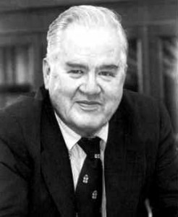

Exploratory Data Analysis 1977
Based on insights developed at Bell Labs in the 60’s
Techniques for visualizing and summarizing data
What can the data tell us? (in contrast to “confirmatory” data analysis)
Introduced many basic techniques:
5-number summary, box plots, stem and leaf diagrams,…
5 Number summary:
extremes (min and max)
median & quartiles
More robust to skewed & longtailed distributions

Slide 8
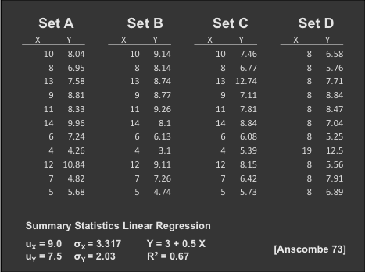
The Trouble with Summary Stats

Slide 9
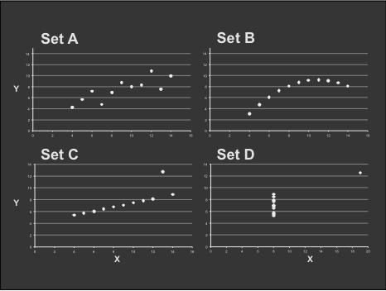
Looking at Data

Slide 10

Data Presentation
Data Art

Slide 11
The “R” Language
An evolution of the “S” language developed at Bell labs for EDA.
Idea was to allow interactive exploration and visualization of data.
The preferred language for statisticians, used by many other data scientists.
Features:
Probably the most comprehensive collection of statistical models and distributions.
CRAN: a very large resource of open source statistical models.
Chart examples from Jeff Hammerbacher’s 2012 CS194 class

Slide 12
Chart types
Single variable
Dot plot
Jitter plot
Error bar plot
Box-and-whisker plot
Histogram
Kernel density estimate
Cumulative distribution function
(note: examples using qplot library from R)
Chart examples from Jeff Hammerbacher’s 2012 CS194 class

Slide 13

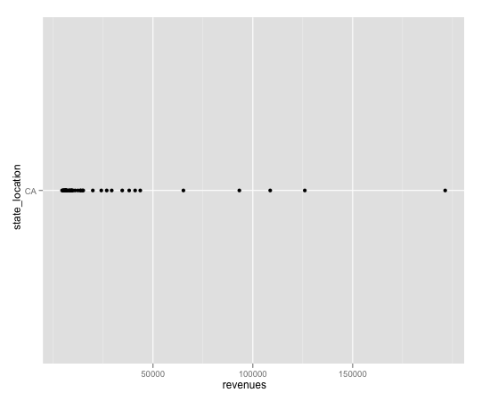
Chart types
Dot plot

Slide 14
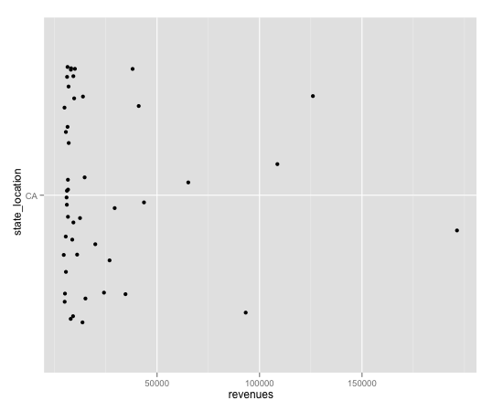
Chart types
Jitter plot
Noise added to the y-axis to spread the points

Slide 15
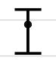
Chart types
Error bars: usually based on confidence intervals (CI). 95% CI means 95% of points are in the range, so 2.5% of points are above or below the bar.
Not necessarily symmetric:

Slide 16
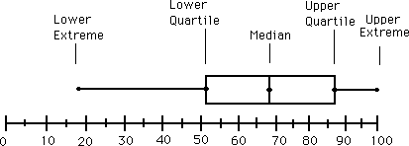
Chart types
Box-and-whisker plot : a graphical form of 5-number summary (Tukey)

Slide 17
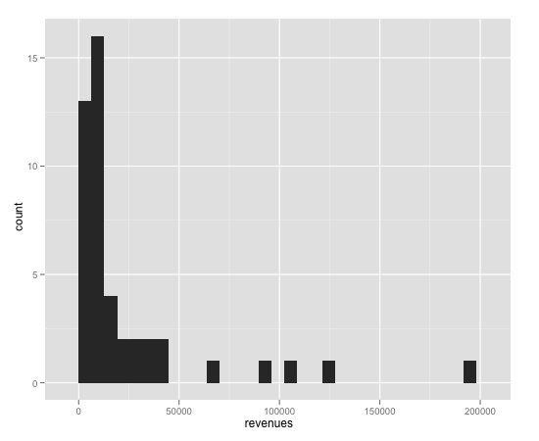
Chart types
Histogram

Slide 18
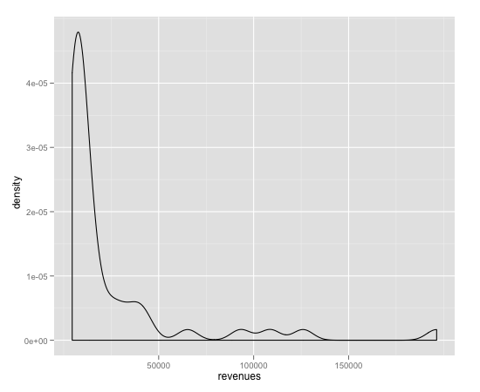
Chart types
Kernel density estimate

Slide 19
Chart types
Histogram and Kernel Density Estimates
Histogram
Proper selection of bin width is important
Outliers should be discarded
KDE (like a smooth histogram)
Kernel function
Box, Epanechnikov, Gaussian
Kernel bandwidth

Slide 20
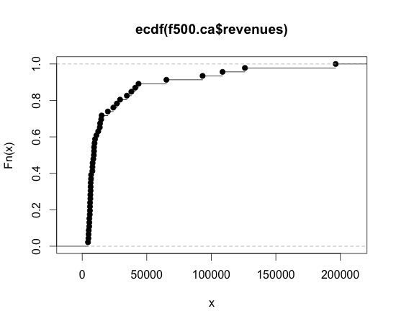
Chart types
Cumulative distribution function
Integral of the histogram – simpler to build than KDE (don’t need smoothing)

Slide 21
Chart types
Two variables
Bar chart
Scatter plot
Line plot
Log-log plot

Slide 22
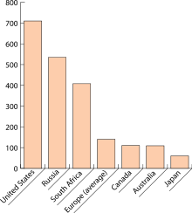
Chart types
Bar plot: one variable is discrete

Slide 23
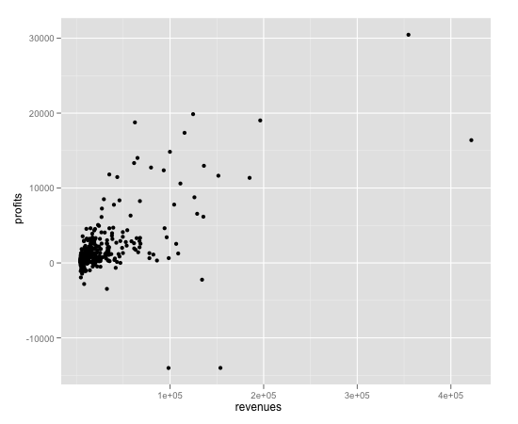
Chart types
Scatter plot

Slide 24
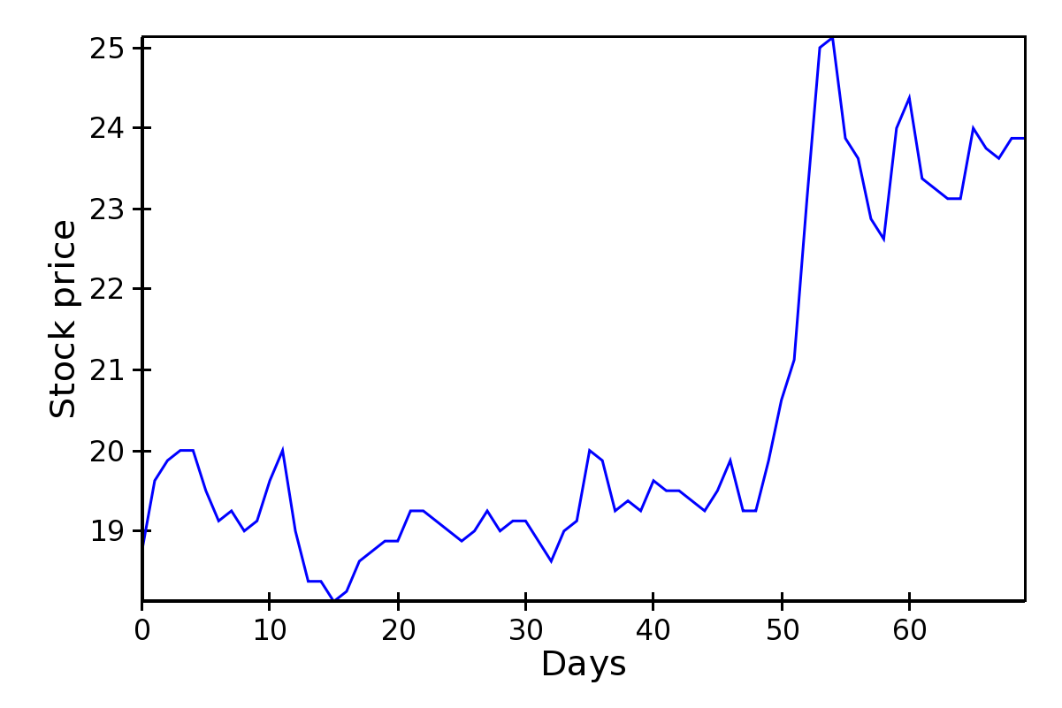
Chart types
Line plot

Slide 25
Chart types
Log-log plot: Very useful for power law data
Frequency of words in tweets
slope ~ -1
Rank of words in tweets, most frequent to least:
I, the, you,…

Slide 26
Chart types
More than two variables
Stacked plots
Parallel coordinate plot

Slide 27
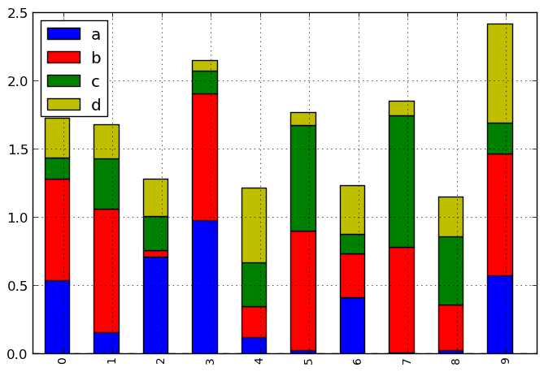
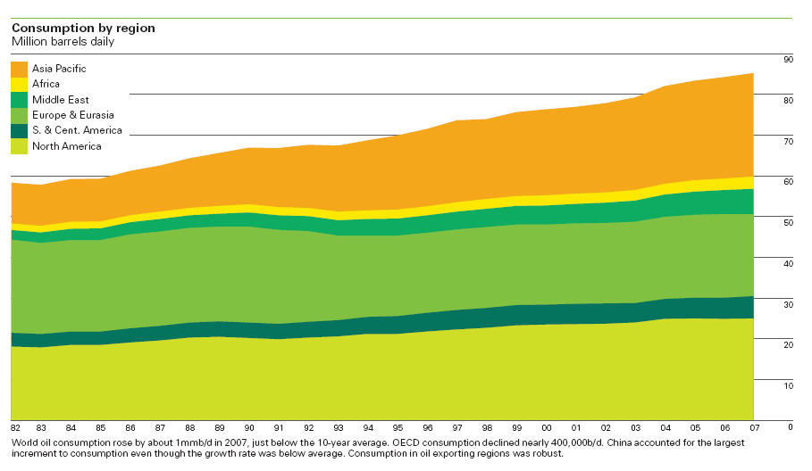
Chart types
Stacked plot: stack variable is discrete:

Slide 28
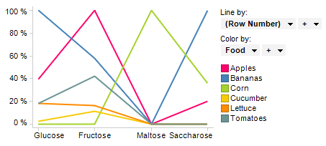
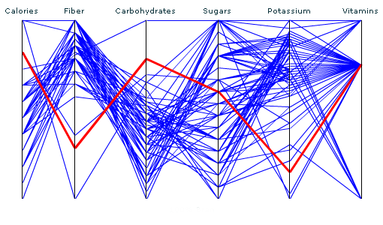
Chart types
Parallel coordinate plot: one discrete variable, an arbitrary number of other variables:

Slide 29
5-minute break

Slide 30
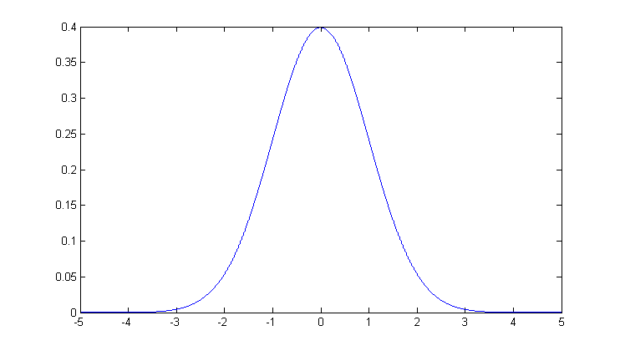
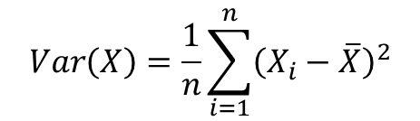
Normal Distributions, Mean, Variance
The mean of a set of values is just the average of the values.
Variance a measure of the width of a distribution. Specifically, the variance is the mean squared deviation of samples from the sample mean:
The standard deviation is the square root of variance.
The normal distribution is completed characterized by mean and variance.
$$Var\left(X\right)=\frac{1}{n}\sum_{i=1}^{n}{{\left(X_{i}−\overline{X}\right)}^{2}}$$
mean
Standard deviation

Slide 31
Central Limit Theorem
The distribution of the sum (or mean) of a set of n identically-distributed random variables Xi approaches a normal distribution as n → ∞.
The common parametric statistical tests, like t-test and ANOVA assume normally-distributed data, but depend on sample mean and variance measures of the data.
They typically work reasonably well for data that are not normally distributed as long as the samples are not too small.

Slide 32
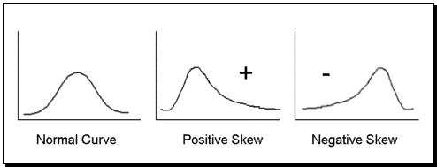
Correcting distributions
Many statistical tools, including mean and variance, t-test, ANOVA etc. assume data are normally distributed.
Very often this is not true. The box-and-whisker plot is a good clue
Whenever its asymmetric, the data cannot be normal. The histogram gives even more information

Slide 33
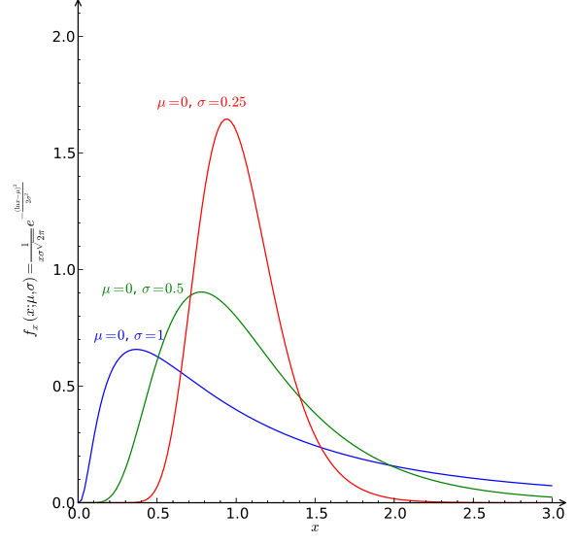
Correcting distributions
In many cases these distribution can be corrected before any other processing.
Examples:
X satisfies a log-normal distribution, Y=log(X) has a normal dist.
X poisson with mean k and sdev. sqrt(k). Then sqrt(X) is approximately normally distributed with sdev 1.

Slide 34
Distributions
Some other important distributions:
Poisson: the distribution of counts that occur at a certain “rate”.
Observed frequency of a given term in a corpus.
Number of visits to a web site in a fixed time interval.
Number of web site clicks in an hour.
Exponential: the interval between two such events.
Zipf/Pareto/Yule distributions: govern the frequencies of different terms in a document, or web site visits.
Binomial/Multinomial: The number of counts of events (e.g. die tosses = 6) out of n trials.
You should understand the distribution of your data before applying any model.

Slide 35
Rhine Paradox*
Autonomy Corp
Joseph Rhine was a parapsychologist in the 1950’s (founder of the Journal of Parapsychology and the Parapsychological Society, an affiliate of the AAAS).
He ran an experiment where subjects had to guess whether 10 hidden cards were red or blue.
He found that about 1 person in 1000 had ESP, i.e. they could guess the color of all 10 cards.
Q: what’s wrong with his conclusion?
* Example from Jeff Ullman/Anand Rajaraman
Notes:
2^10 ~ 1000 so 1 in 1000 is just the rate by of guessing correctly by chance

Slide 36
Rhine Paradox
Autonomy Corp
He called back the “psychic” subjects and had them do the same test again. They all failed.
He concluded that the act of telling psychics that they have psychic abilities causes them to lose it…(!)

Slide 37
Hypothesis Testing
We want to prove a hypothesis H_{A}, but its hard so we try to disprove a null hypothesis H₀.
A test statistic is some measurement we can make on the data which is likely to be big under H_{A} but small under H₀.
We chose a test statistic whose distribution we know if H₀ is true: e.g.
Two samples a and b, normally distributed, from A and B.
H₀ hypothesis that mean(A) = mean(B), test statistic is: s = mean(a) – mean(b).
s has mean zero and is normally distributed under H₀.
But its “large” if the two means are different.

Slide 38
Hypothesis Testing – contd.
s = mean(a) – mean(b) is our test statistic, H₀ the hypothesis that mean(A)=mean(B)
We reject if Pr(x > s | H₀ ) < p
p is a suitable “small” probability, say 0.05.
This threshold probability is called a p-value.
P directly controls the false positive rate (rate at which we expect to observe large s even if is H₀ true).
As we make p smaller, the false negative rate increase – situations where mean(A), mean(B) differ but the test fails.
Common values 0.05, 0.02, 0.01, 0.005, 0.001

Slide 39
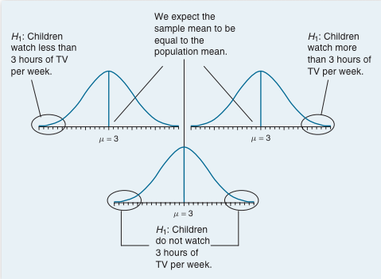
From G.J. Primavera, “Statistics for the Behavioral Sciences”

Slide 40
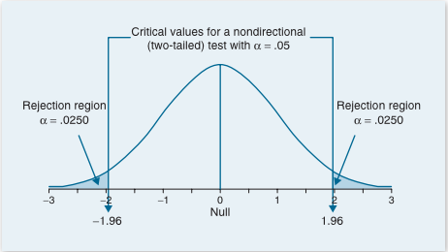
Two-tailed Significance
From G.J. Primavera, “Statistics for the Behavioral Sciences”
When the p value is less than 5% (p < .05), we reject the null hypothesis

Slide 41
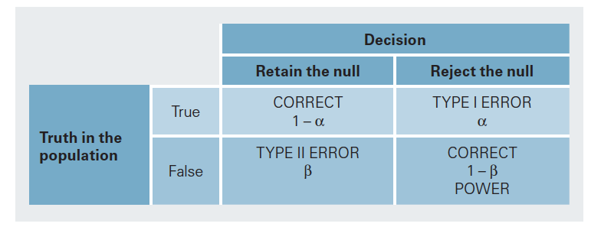
Hypothesis Testing
From G.J. Primavera, “Statistics for the Behavioral Sciences”

Slide 42
Three important tests
T-test: compare two groups, or two interventions on one group.
CHI-squared and Fisher’s test. Compare the counts in a “contingency table”.
ANOVA: compare outcomes under several discrete interventions.

Slide 43
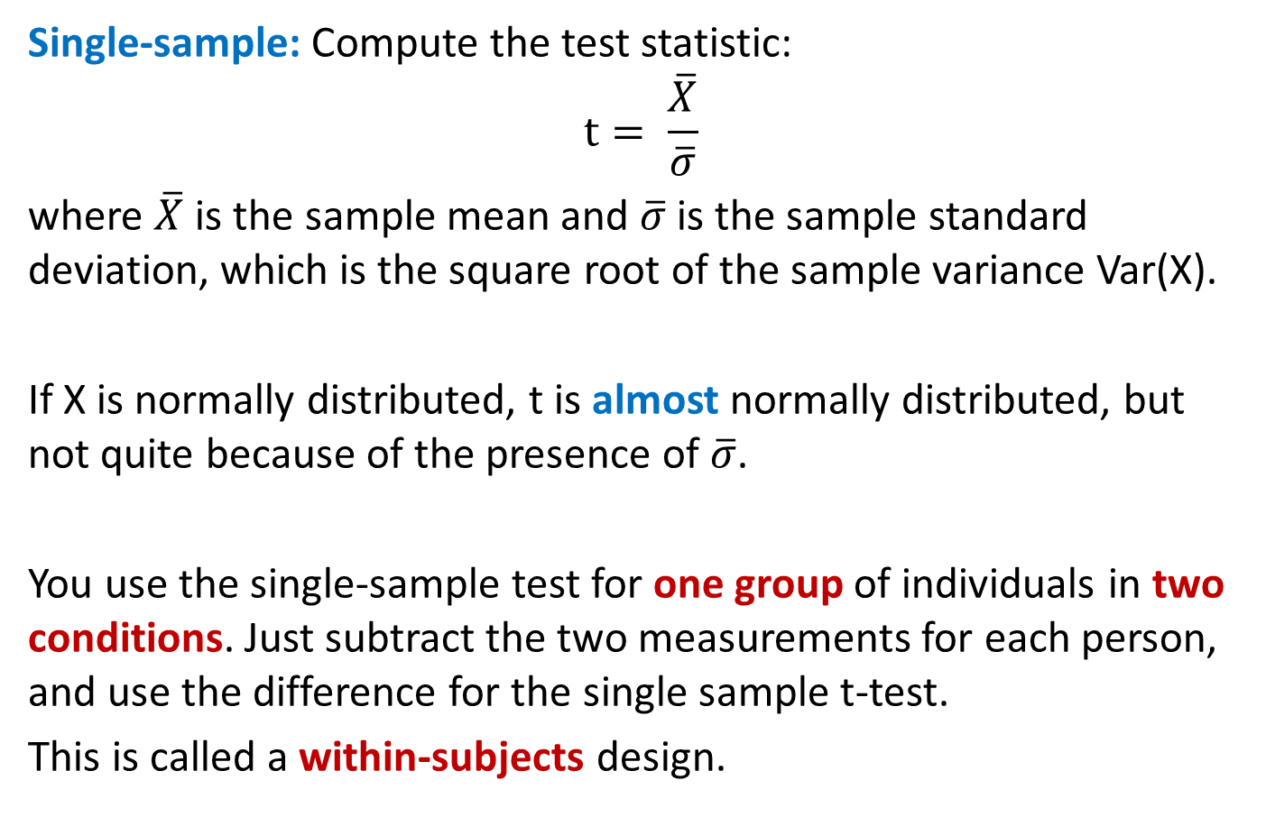
T-test
Single-sample: Compute the test statistic: $$t= \frac{\overline{X}}{\overline{σ}}$$
where $\overline{X}$ is the sample mean and $\overline{σ}$ is the sample standard deviation, which is the square root of the sample variance Var(X).
If X is normally distributed, t is almost normally distributed, but not quite because of the presence of $\overline{σ}$.
You use the single-sample test for one group of individuals in two conditions. Just subtract the two measurements for each person, and use the difference for the single sample t-test.
This is called a within-subjects design.

Slide 44
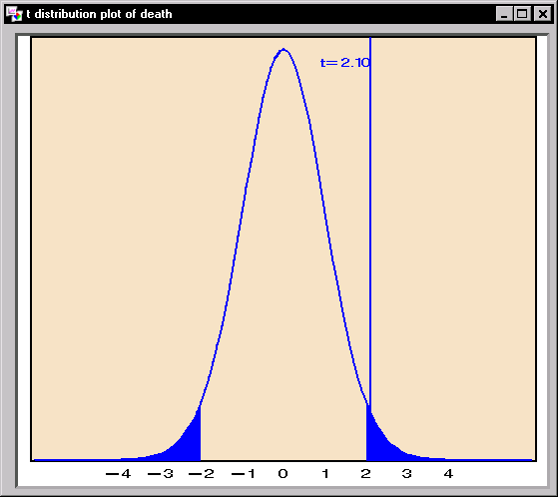
T-statistic and T-distribution
We use the t-statistic from the last slide to test whether the mean of our sample could be zero.
If the underlying population has mean zero, the t-distribution should be distributed like this:
The area of the tail beyond our measurement tells us how likely it is under the null hypothesis.
If that probability is low (say < 0.05) we reject the null hypothesis.

Slide 45


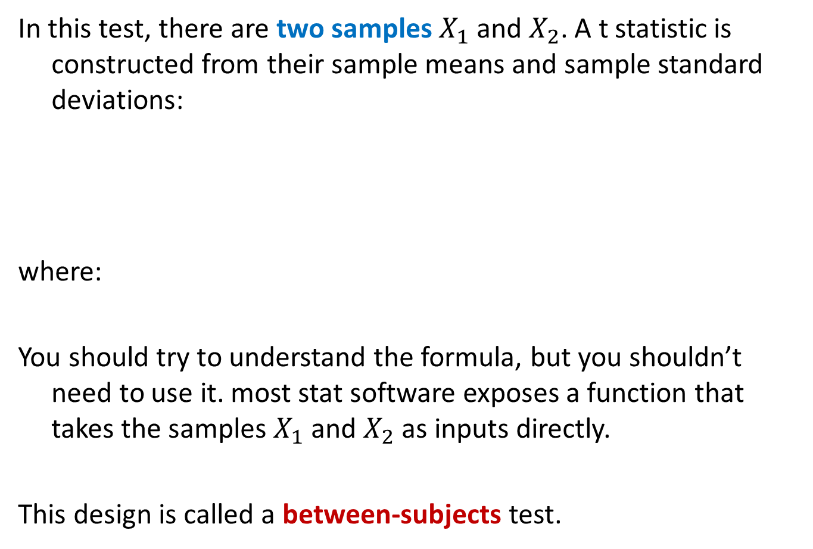
Two sample T-test
In this test, there are two samples $X_{1}$ and $X_{2}$. A t statistic is constructed from their sample means and sample standard deviations:
where:
You should try to understand the formula, but you shouldn’t need to use it. most stat software exposes a function that takes the samples $X_{1}$ and $X_{2}$ as inputs directly.
This design is called a between-subjects test.

Slide 46

Chi-squared test
Often you will be faced with discrete (count) data. Given a table like this:
Where Prob(X) is part of a null hypothesis about the data (e.g. that a coin is fair).
The CHI-squared statistic lets you test whether an observation is consistent with the data:
O_{i} is an observed count, and E_{i} is the expected value of that count. It has a chi-squared distribution, whose p-values you compute to do the test.
 | Prob(X) | Count(X)
X=0 | 0.3 | 10
X=1 | 0.7 | 50

Slide 47
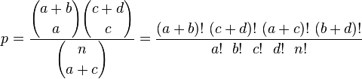
Fisher’s exact test
In case we only have counts under different conditions
We can use Fisher’s exact test (n = a+b+c+d):
Which gives the probability directly (its not a statistic).
 | Count1(X) | Count2(X)
X=0 | a | b
X=1 | c | d

Slide 48
One-Way ANOVA
ANOVA (ANalysis Of VAriance) allows testing of multiple differences in a single test. Suppose our experiment design has an independent variable Y with four levels:
The table shows the mean values of a response variable (e.g. avg number of Facebook posts per day) in each group.
We would like to know in a single test whether the response variable depends on Y, at some particular significance such as 0.05.
Y
Primary School | High School | College | Grad degree
4.1 | 4.5 | 4.2 | 3.8

Slide 49
ANOVA
In ANOVA we compute a single statistic (an F-statistic) that compares variance between groups with variance within each group.
The higher the F-value is, the less probable is the null hypothesis that the samples all come from the same population.
We can look up the F-statistic value in a cumulative F-distribution (similar to the other statistics) to get the p-value.
ANOVA tests can be much more complicated, with multiple dependent variables, hierarchies of variables, correlated measurements etc.

Slide 50
Closing Words
All the tests so far are parametric tests that assume the data are normally distributed, and that the samples are independent of each other and all have the same distribution (IID).
They may be arbitrarily inaccurate is those assumptions are not met. Always make sure your data satisfies the assumptions of the test you’re using. e.g. watch out for:
Outliers – will corrupt many tests that use variance estimates.
Correlated values as samples, e.g. if you repeated measurements on the same subject.
Skewed distributions – give invalid results.

Slide 51
Non-parametric tests
These tests make no assumption about the distribution of the input data, and can be used on very general datasets:
K-S test
Permutation tests
Bootstrap confidence intervals

Slide 52
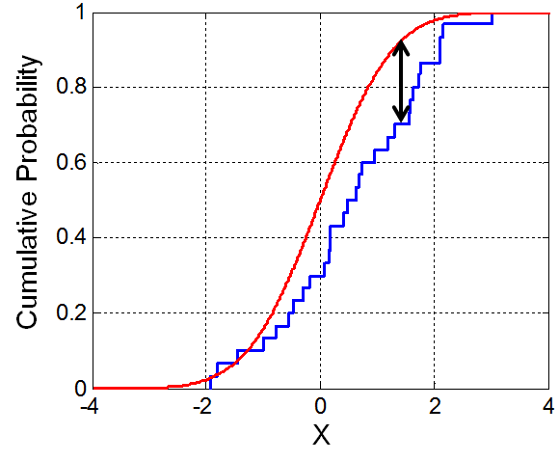
K-S test
The K-S (Kolmogorov-Smirnov) test is a very useful test for checking whether two (continuous or discrete) distributions are the same.
In the one-sided test, an observed distribution (e.g. some observed values or a histogram) is compared against a reference distribution.
In the two-sided test, two observed distributions are compared.
The K-S statistic is just the max distance between the CDFs of the two distributions.
While the statistic is simple, its distribution is not!
But it is available in most stat packages.

Slide 53
K-S test
The K-S test can be used to test whether a data sample has a normal distribution or not.
Thus it can be used as a sanity check for any common parametric test (which assumes normally-distributed data).
It can also be used to compare distributions of data values in a large data pipeline: Most errors will distort the distribution of a data parameter and a K-S test can detect this.

Slide 54
Non-parametric tests
Permutation tests
Bootstrap confidence intervals
We wont discuss these in detail, but its important to know that non-parametric tests using one of the above methods exist for many forms of hypothesis.
They make no assumptions about the distribution of the data, but in many cases are just as sensitive as parametric tests.
They use computational cycles to simulate sample data, to derive p-value estimates approximately, and accuracy improves with the amount of computational work done.

Slide 55
Outline
Exploratory Data Analysis
Chart types
Some important distributions
Hypothesis Testing

